Slide 1


Slide 2

Jordi Montana
What’s new in TDD for Dynamics 365 CE / CDS

Slide 3





JORDI MONTANA
Founder at https://dynamicsvalue.com
Author of #FakeXrmEasy
2 x Microsoft Business Applications MVP
Passionate about OSS and Dev technologies
@jordimontana http://www.linkedin.com/in/jordimontana

Slide 4
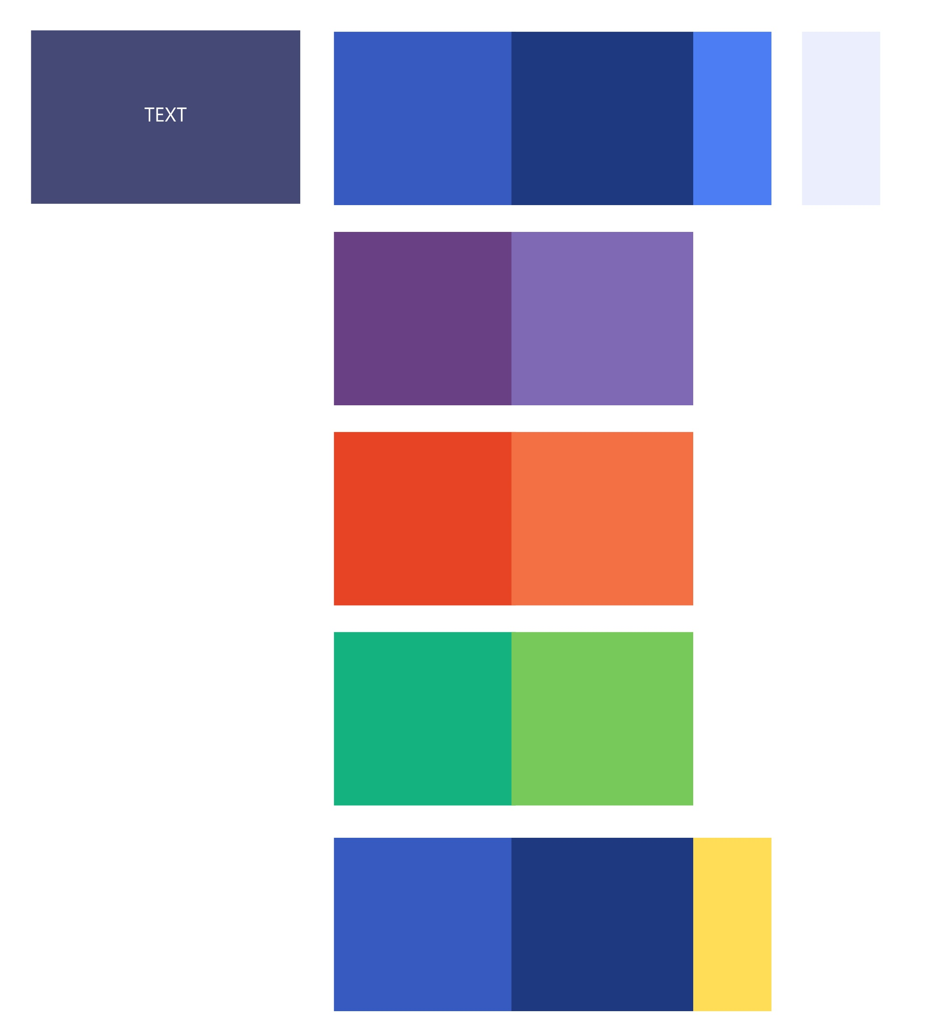
Agenda
Why unit testing / test automation?
Super brief intro to DevOps
Test Automation using OSS technologies
What’s new in TDD for Dynamics 365 CE
https://github.com/jordimontana82/365saturday-kyiv-2019

Slide 5
Why unit testing / test automation?

Slide 6

Why unit testing / test automation?

Slide 7



What is DevOps / CI / CD?
Fast
Continuous Business
Value
DevOps
Plan
Code
Build
Test
Release
Deploy
Monitor
Feedback
Automation

Slide 8

Test Automation
Unit Testing
Integration Testing
UI Testing
Unit Testing
Integration Testing
UI Testing
System Tests
Trigger from Build
Visual Studio / Build
CRM Env. (QA)

Slide 9
Unit Testing / TDD in Dynamics CE / CDS
.NET
FakeXrmEasy (NuGet)
Unit Testing
fakexrmeasy (npm)
xrm-mock (npm)
Javascript / Typescript
PCF controls (React soon?)

Slide 10
What’s new … ?
New messages and features added to #FakeXrmEasy
FakeXrmEasy.js completely rewritten to remove edge.js dependency (give it a try… pull requests are welcome :P)
It runs exclusively in the node process only now
Enables not just client-side, but server side unit test testing against Web API (i.e. only if you are brave enough to use Node.js for server side applications against CDS :P)
PowerApps Component Framework CLI: React-based… although react components not yet supported

Slide 11
What’s new … ?
DEMO TIME

Slide 12


